Slide 1
Chapter 5 The demand for labor in the Long run

Slide 2
Chapter Summary
The distinctive feature of the long run is a sufficiently long period of time for the firm to vary the amount of both labor and capital in response to changes in factor prices, product demand, and technology.
Over time technological change and productivity growth continuously reduce the amount of labor needed to produce a unit of output.

Slide 3
Technology of production: Isoquants
The goal of the firm is to produce the level of output that maximizes profit. To accomplish this, the firm must decide on the least-cost production method and, in particular on the appropriate combination of capital and labor. This decision is influenced by two considerations:
First, the constraints that technology places on the mix of capital and labor.
Second, the relative prices of the factor inputs.

Slide 4
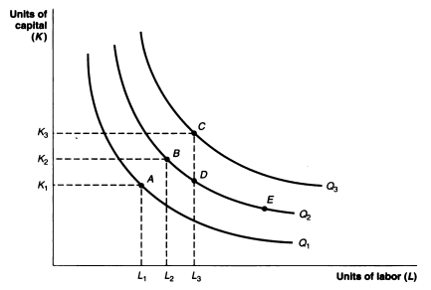
A set of isoquants

Slide 5
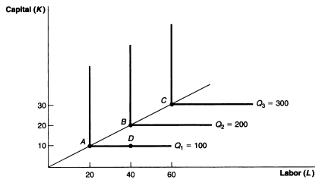
Production technology with zero substitution possibilities

Slide 6
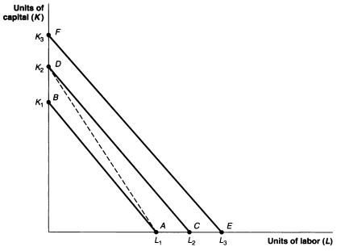
A set of Isocost line

Slide 7
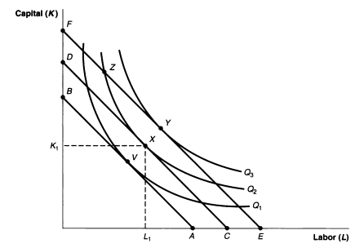
The profit maximizing combination of capital and labor

Slide 8
The Change in the Short-run and Long-run Demand for Labor due a Wage Increase
The rise in the wage causes the firm’s demand for labor fall in the short run due to the scale effect as the firm cuts back its production level.
In long-run, the firm is able to substitute capital for labor in the production line, leading to a further decline in labor demand due to substitution effect.
The decline in labor demand due to the decrease in the level of production is known as the scale effect.
The resulting change in labor demand due to capital/ labor substitution is known as the substation effect.

Slide 9
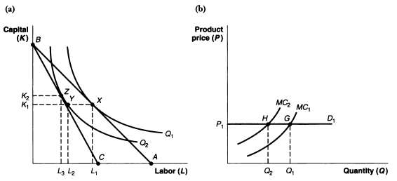
The Change in the Short-run and Long-run Demand for Labor due a Wage Increase

Slide 10
The long-run demand curve for labor
The long-run demand curve is more elastic than the short-demand curve.
In the short-run, the firm’s ability to adjust to a wage increase is limited because it is locked into a fixed amount of capital.
In the long-run, however, the ability to change not only the level of production but also the amount of capital provides the firm with much more flexibility in adapting to higher or lower wages, resulting in a demand curve for labor that is more sensitive than to changes in wage costs in the long-run than in the short run.

Slide 11
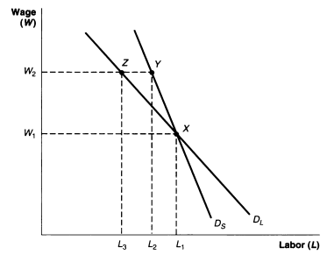
The long-run demand curve for labor

Slide 12
The effect of technological change on labor demand
Technological change has a two-pronged effect on the demand for labor.
The initial effect is to reduce the demand for labor as better technology allows firms to produce a given level of output with fewer workers.
The second effect is that improved technology results in lower production costs and, thus, lower product prices, increased sales, and a greater demand for labor.

Slide 13
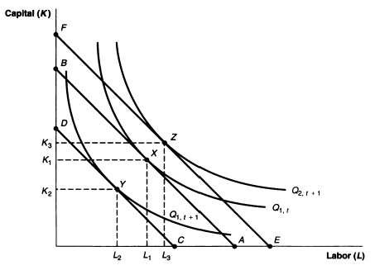
The effect of technological change on labor demand

Slide 14
The impact of technological change on the long-run labor demand
Give the wage rate W1, the first impact of technological change is to displace labor as better technology enables the firm to produce same level of output, say Q1, with less labor. This shifts the long-run labor demand curve to the left.
The resulting decline in the production price, however, stimulates an increase in sales to Q2, leading to a rightward of the labor demand curve.

Slide 15
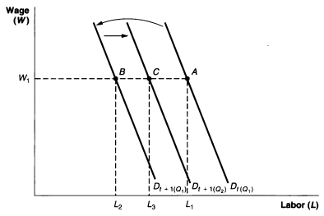
The impact of technological change on the long-run labor demand

Slide 16
The effect of changing factor prices on employment forecasting
Given the existing employment of L1, to forecast the future level of employment it is necessary to predict the level of output. Assuming the level of output to be Q2, if isoquants are convex allowing substitution possibilities between K and L, it is also necessary to predict the change in relative factor prices and the curvature of the isoquants.

Slide 17
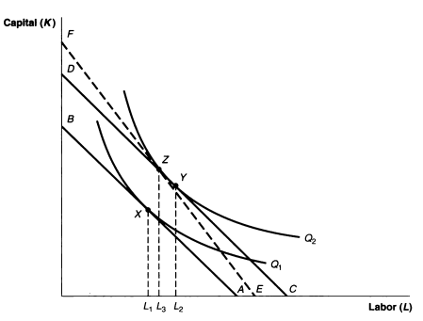
The effect of changing factor prices on employment forecasting

